Slide 1
CS 485/685 Computer Vision
Face Recognition Using Principal Components Analysis (PCA)
M. Turk, A. Pentland, "Eigenfaces for Recognition", Journal of Cognitive Neuroscience, 3(1), pp. 71-86, 1991.
Notes:
Good afternoon and thank you everyone for coming.
My talk today will describe the research I performed at the IRIS at USC, the object of this work being to build a computational framework that addresses the problem of motion analysis and interpretation.

Slide 2
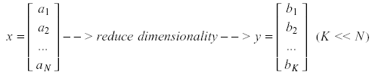
Principal Component Analysis (PCA)
Pattern recognition in high-dimensional spaces
Problems arise when performing recognition in a high-dimensional space (curse of dimensionality).
Significant improvements can be achieved by first mapping the data into a lower-dimensional sub-space.
The goal of PCA is to reduce the dimensionality of the data while retaining as much information as possible in the original dataset.

Slide 3
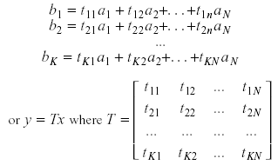
Principal Component Analysis (PCA)
Dimensionality reduction
PCA allows us to compute a linear transformation that maps data from a high dimensional space to a lower dimensional sub-space.
K x N

Slide 4


Principal Component Analysis (PCA)
Lower dimensionality basis
Approximate vectors by finding a basis in an appropriate lower dimensional space.
(1) Higher-dimensional space representation:
(2) Lower-dimensional space representation:

Slide 5

Principal Component Analysis (PCA)
Information loss
Dimensionality reduction implies information loss!
PCA preserves as much information as possible, that is, it
minimizes the error:
How should we determine the best lower dimensional sub-space?

Slide 6
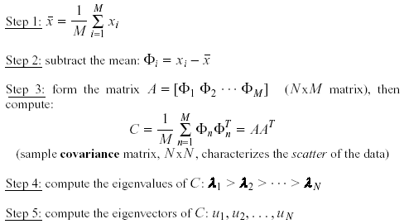
Principal Component Analysis (PCA)
Methodology
Suppose x₁, x₂, ..., x_{M} are N x 1 vectors
(i.e., center at zero)

Slide 7
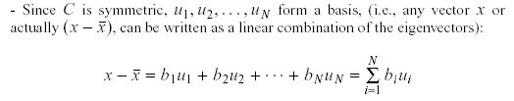
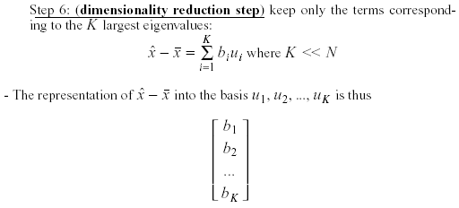

Principal Component Analysis (PCA)
Methodology – cont.
$$A=πr^{2}$$

Slide 8
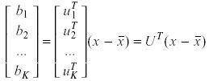
Principal Component Analysis (PCA)
Linear transformation implied by PCA
The linear transformation R^{N} → R^{K} that performs the dimensionality reduction is:
(i.e., simply computing coefficients of linear expansion)

Slide 9
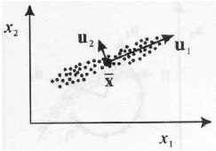
Principal Component Analysis (PCA)
Geometric interpretation
PCA projects the data along the directions where the data varies the most.
These directions are determined by the eigenvectors of the covariance matrix corresponding to the largest eigenvalues.
The magnitude of the eigenvalues corresponds to the variance of the data along the eigenvector directions.

Slide 10

Principal Component Analysis (PCA)
How to choose K (i.e., number of principal components) ?
To choose K, use the following criterion:
In this case, we say that we “preserve” 90% or 95% of the
information in our data.
If K=N, then we “preserve” 100% of the information in our data.

Slide 11


Principal Component Analysis (PCA)
What is the error due to dimensionality reduction?
The original vector x can be reconstructed using its principal components:
PCA minimizes the reconstruction error:
It can be shown that the error is equal to:

Slide 12

Principal Component Analysis (PCA)
Standardization
The principal components are dependent on the units used to measure the original variables as well as on the range of values they assume.
You should always standardize the data prior to using PCA.
A common standardization method is to transform all the data to have zero mean and unit standard deviation:

Slide 13
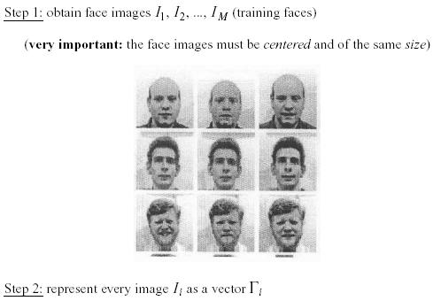
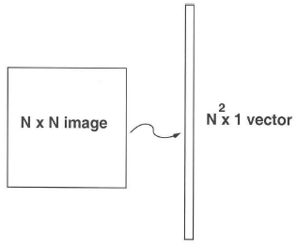
Application to Faces
Computation of low-dimensional basis (i.e.,eigenfaces):

Slide 14
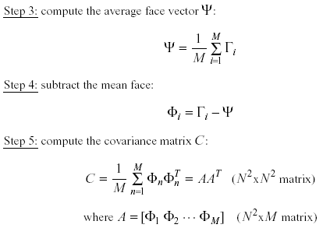
Application to Faces
Computation of the eigenfaces – cont.

Slide 15
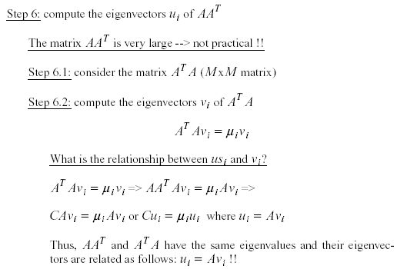
Application to Faces
Computation of the eigenfaces – cont.
u_{i}

Slide 16
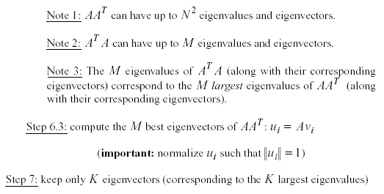
Application to Faces
Computation of the eigenfaces – cont.

Slide 17
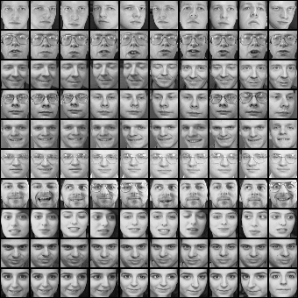
Eigenfaces example
Training images
Notes:
17

Slide 18
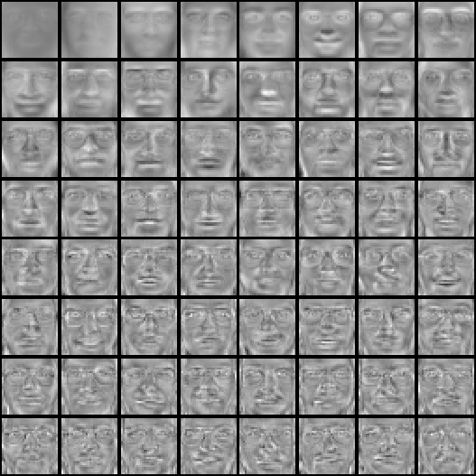

Eigenfaces example
Top eigenvectors: u₁,…u_{k}
Mean: μ
Notes:
18

Slide 19
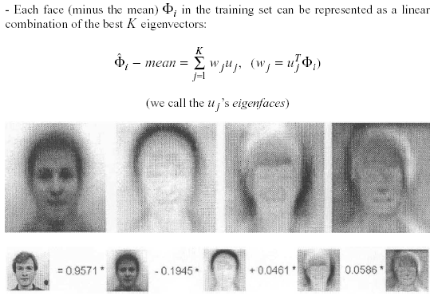
Application to Faces
Representing faces onto this basis
Face reconstruction:

Slide 20

Eigenfaces
Case Study: Eigenfaces for Face Detection/Recognition
M. Turk, A. Pentland, "Eigenfaces for Recognition", Journal of Cognitive Neuroscience, vol. 3, no. 1, pp. 71-86, 1991.
Face Recognition
The simplest approach is to think of it as a template matching problem
Problems arise when performing recognition in a high-dimensional space.
Significant improvements can be achieved by first mapping the data into a lower dimensionality space.

Slide 21
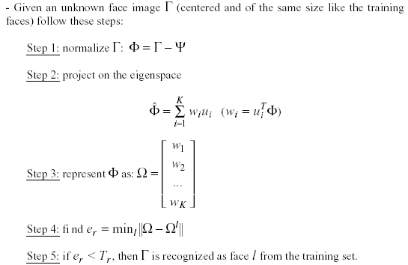
Eigenfaces
Face Recognition Using Eigenfaces
where

Slide 22

Eigenfaces
Face Recognition Using Eigenfaces – cont.
The distance e_{r} is called distance within face space (difs)
The Euclidean distance can be used to compute e_{r}, however, the Mahalanobis distance has shown to work better:
Euclidean distance
Mahalanobis distance

Slide 23


Face detection and recognition
Detection
Recognition
“Sally”
Notes:
23

Slide 24
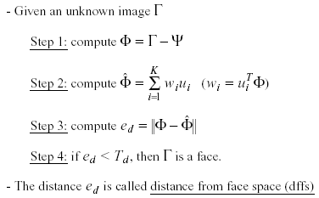
Eigenfaces
Face Detection Using Eigenfaces
The distance e_{d} is called distance from face space (dffs)

Slide 25
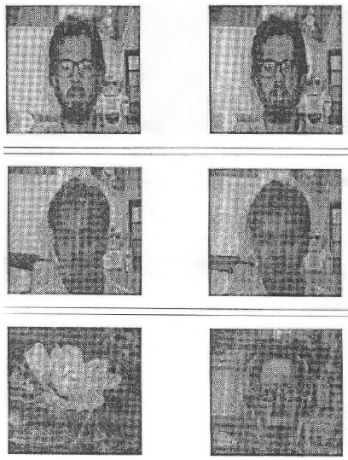
Eigenfaces
Reconstruction of faces and non-faces
Input Reconstructed
Reconstructed face looks
like a face.
Reconstructed non-face
looks like a fac again!

Slide 26
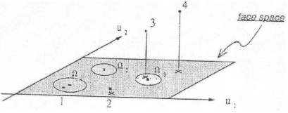
Eigenfaces
Face Detection Using Eigenfaces – cont.
Case 1: in face space AND close to a given face
Case 2: in face space but NOT close to any given face
Case 3: not in face space AND close to a given face
Case 4: not in face space and NOT close to any given face

Slide 27

Reconstruction using partial information
Robust to partial face occlusion.
Input Reconstructed

Slide 28
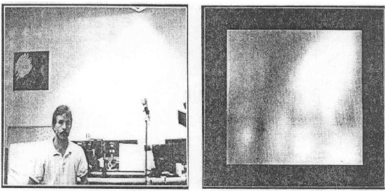
Eigenfaces
Face detection, tracking, and recognition
Visualize dffs:

Slide 29

Limitations
Background changes cause problems
De-emphasize the outside of the face (e.g., by multiplying the input image by a 2D Gaussian window centered on the face).
Light changes degrade performance
Light normalization helps.
Performance decreases quickly with changes to face size
Multi-scale eigenspaces.
Scale input image to multiple sizes.
Performance decreases with changes to face orientation (but not as fast as with scale changes)
Plane rotations are easier to handle.
Out-of-plane rotations are more difficult to handle.

Slide 30


Limitations
Not robust to misalignment
Notes:
30

Slide 31
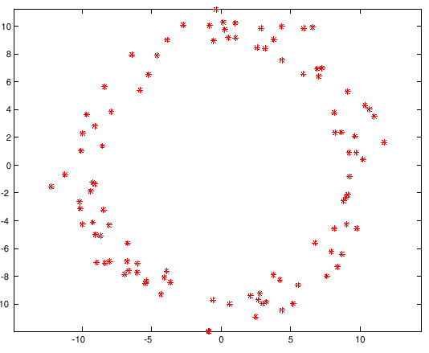
Limitations
PCA assumes that the data follows a Gaussian distribution (mean µ, covariance matrix Σ)
The shape of this dataset is not well described by its principal components
Notes:
31

Slide 32
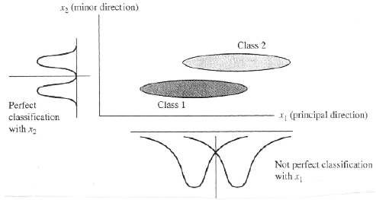
Limitations
PCA is not always an optimal dimensionality-reduction procedure for classification purposes:

